Slide 1


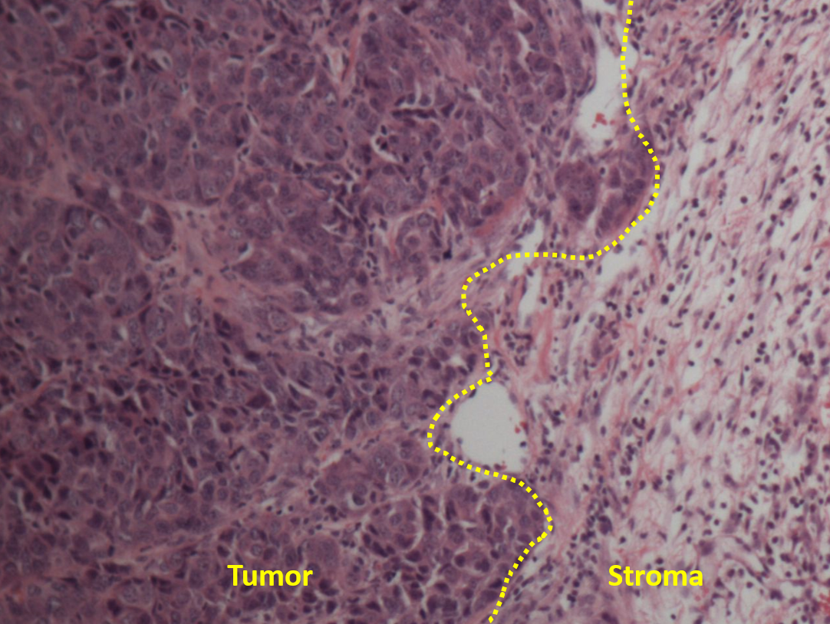
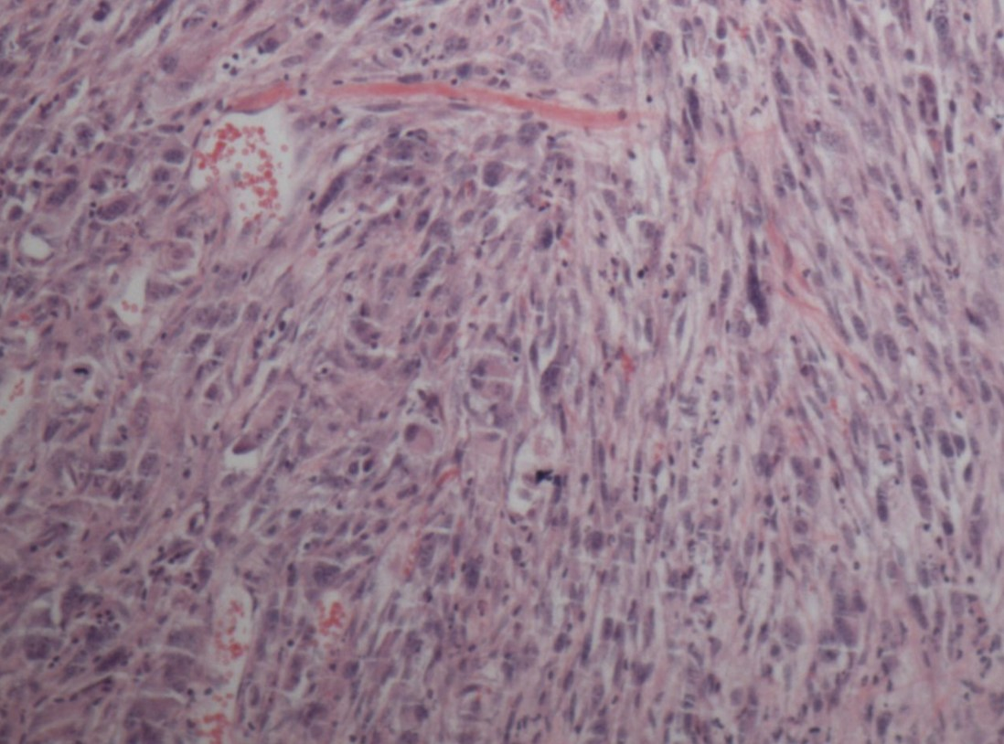
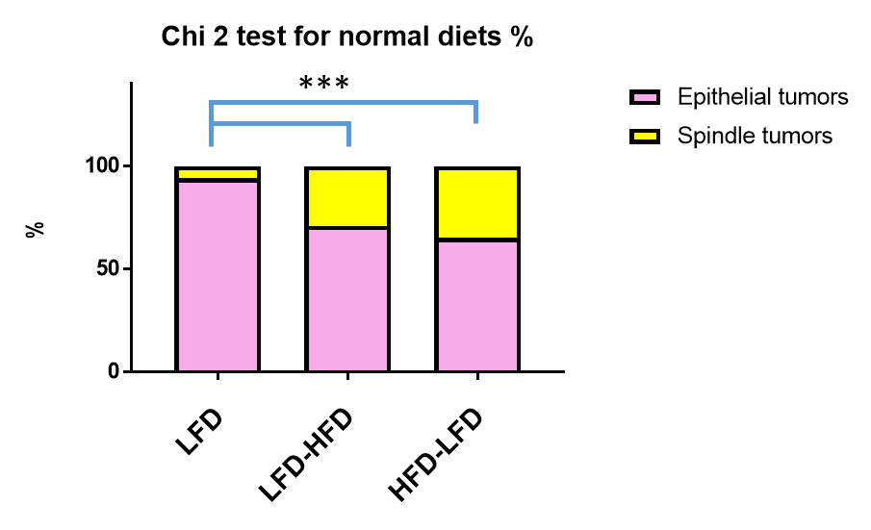
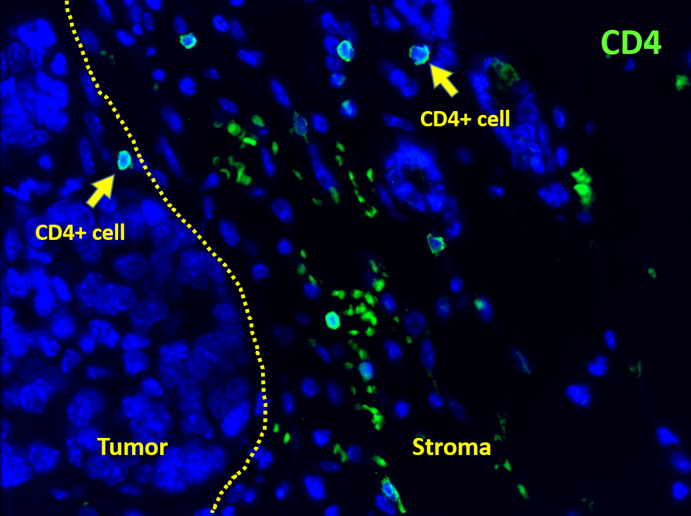
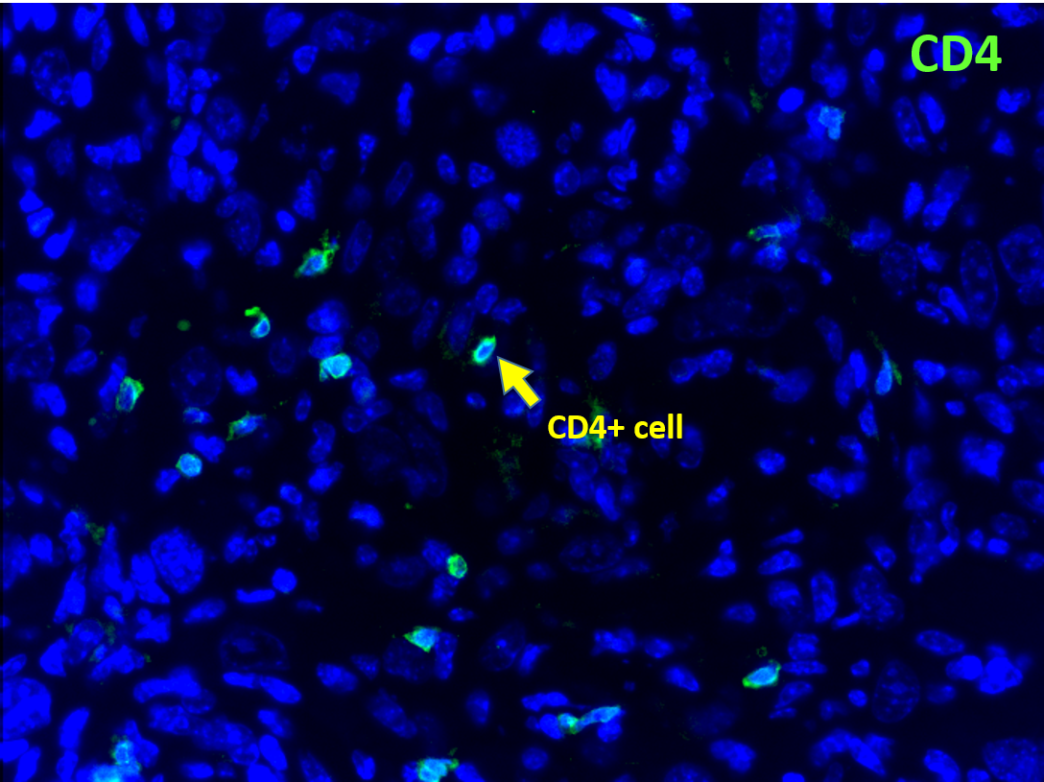
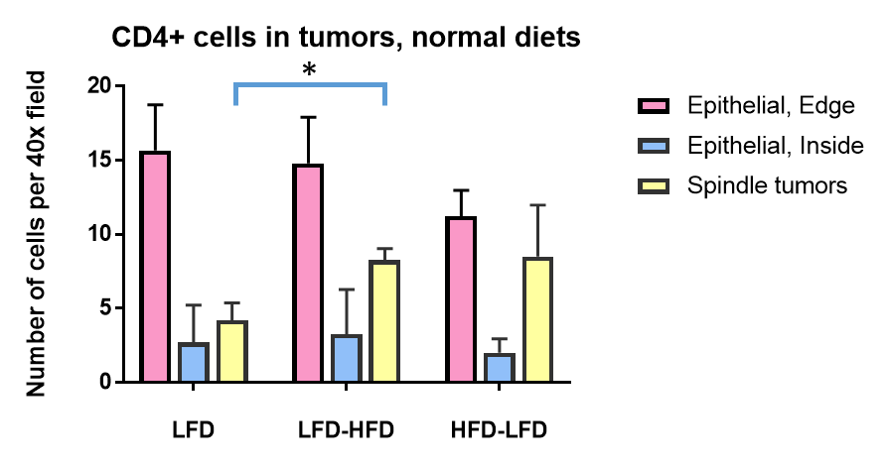
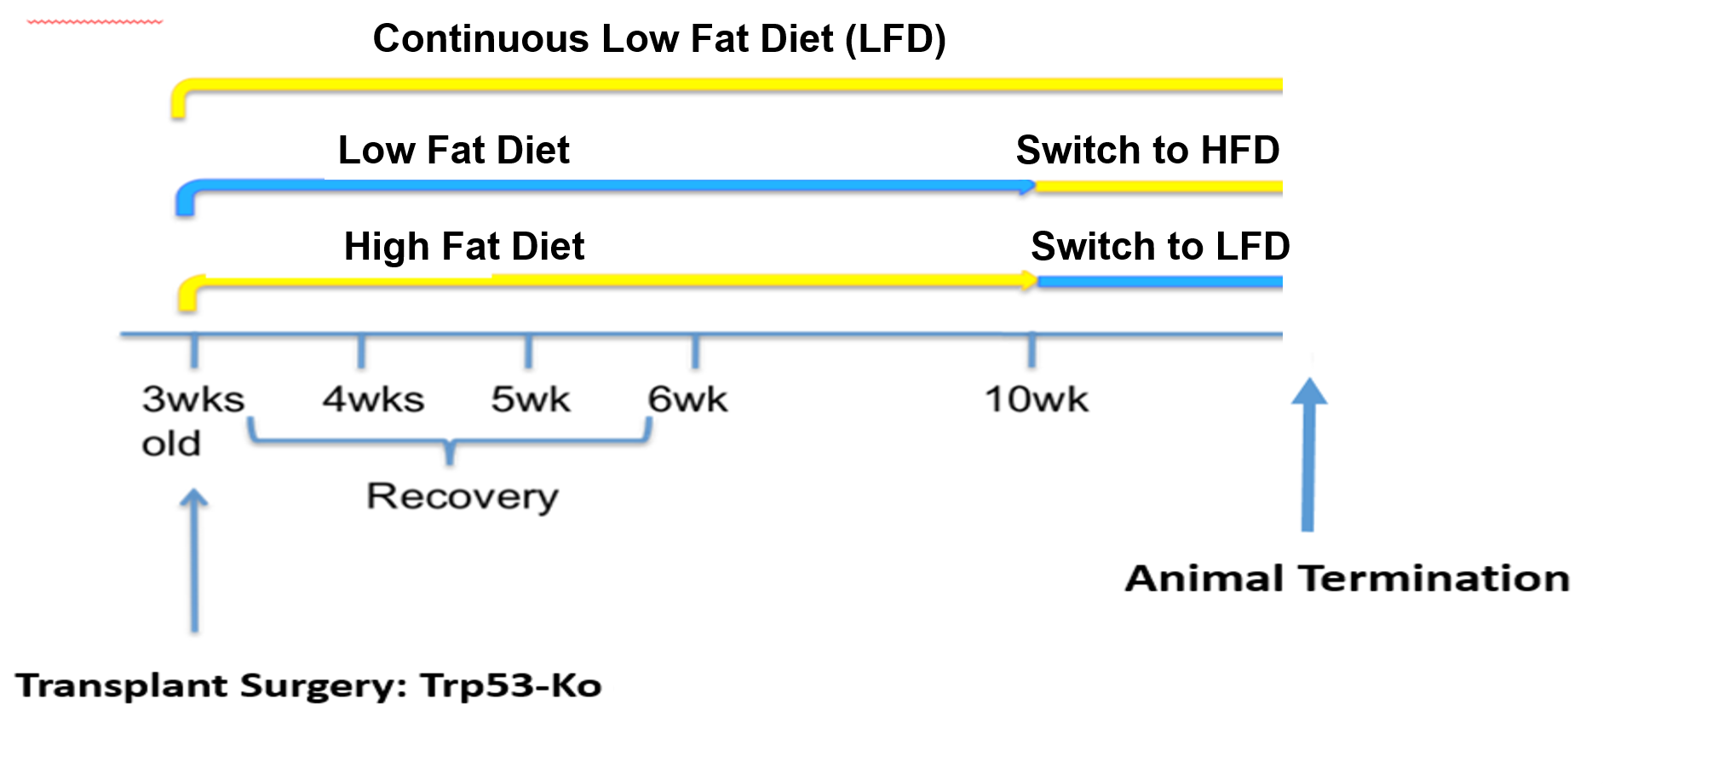
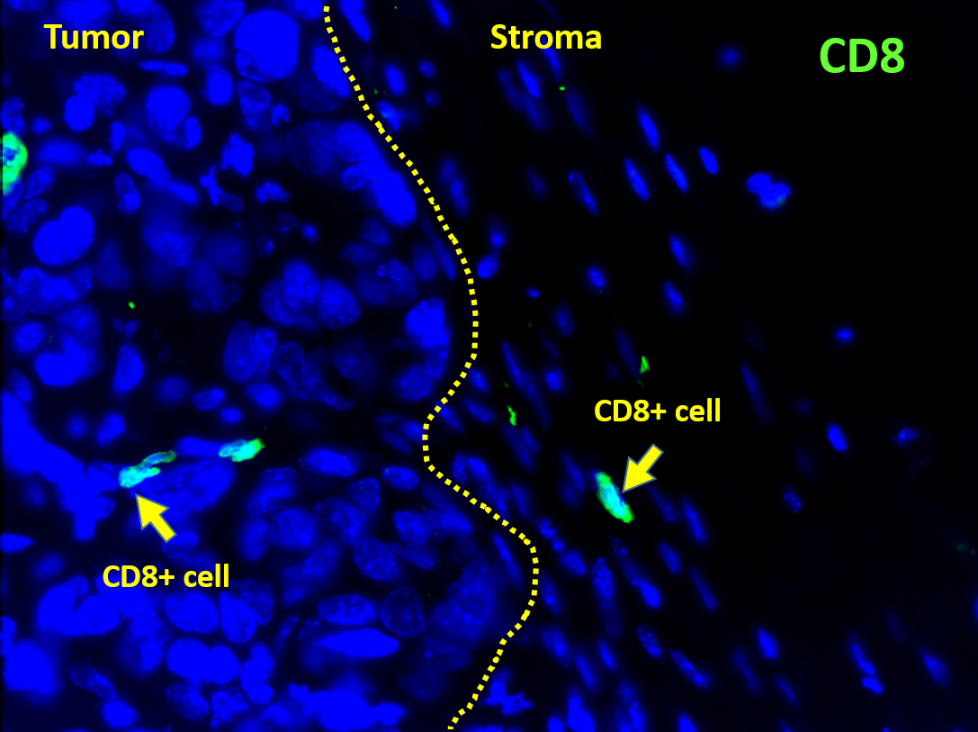
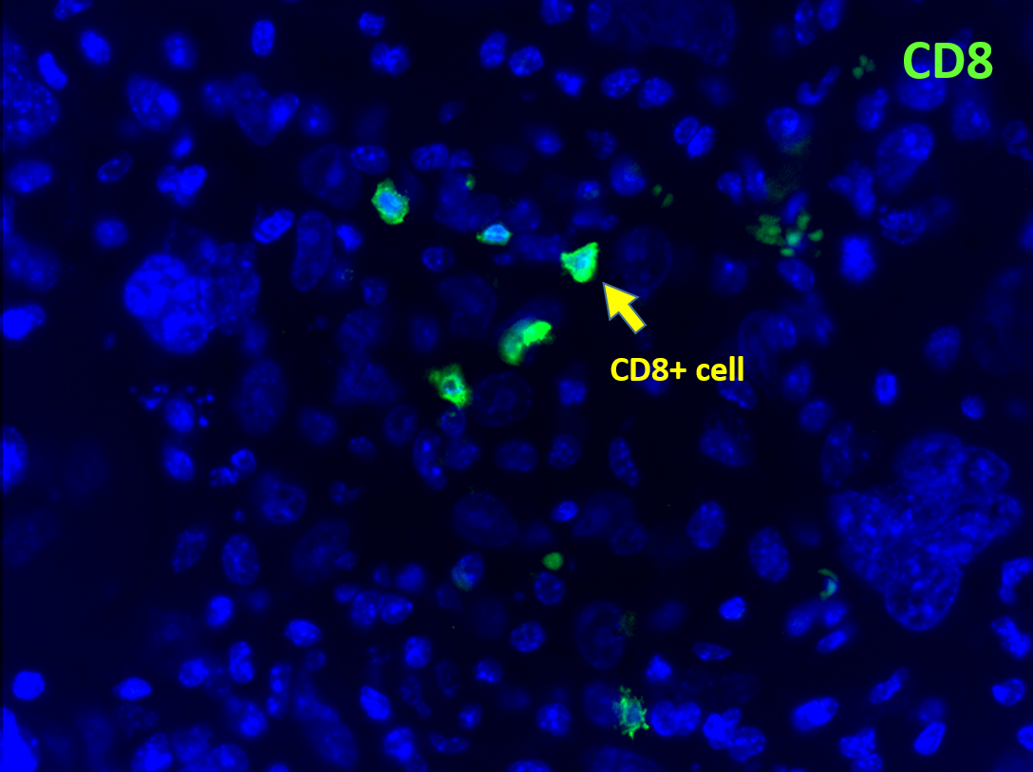
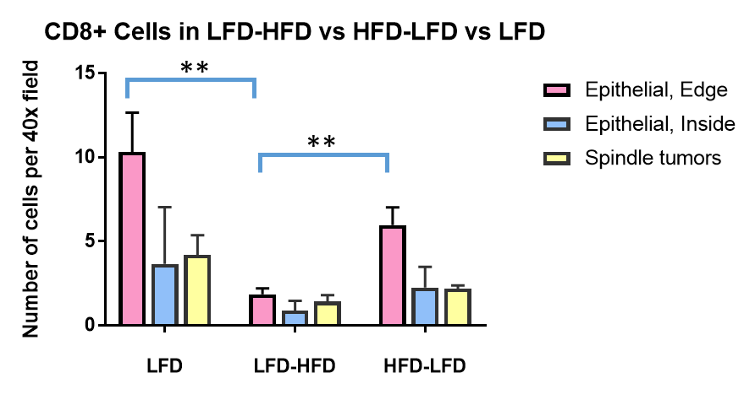
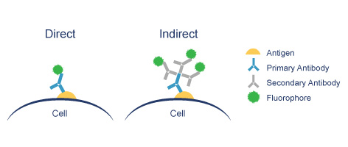
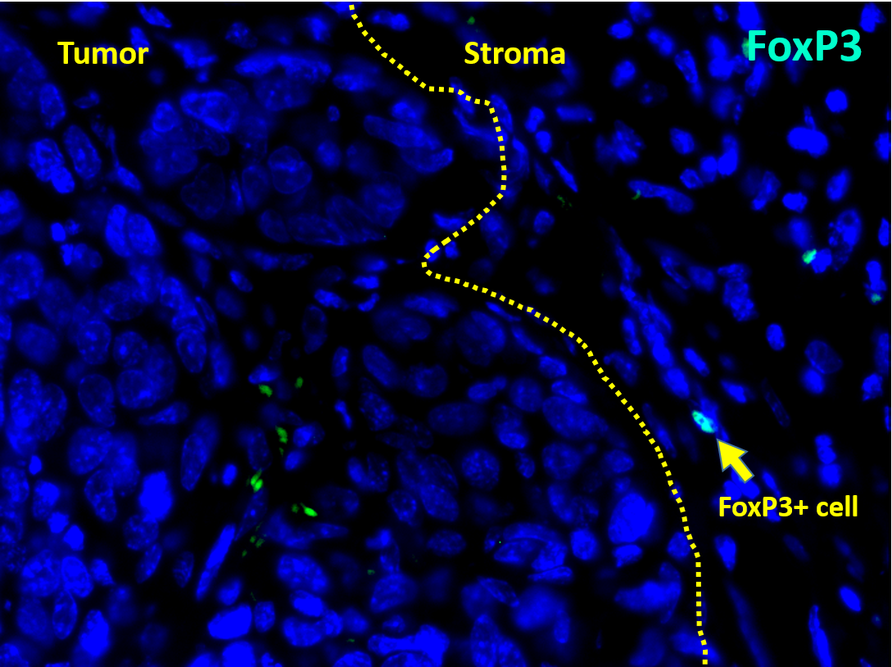
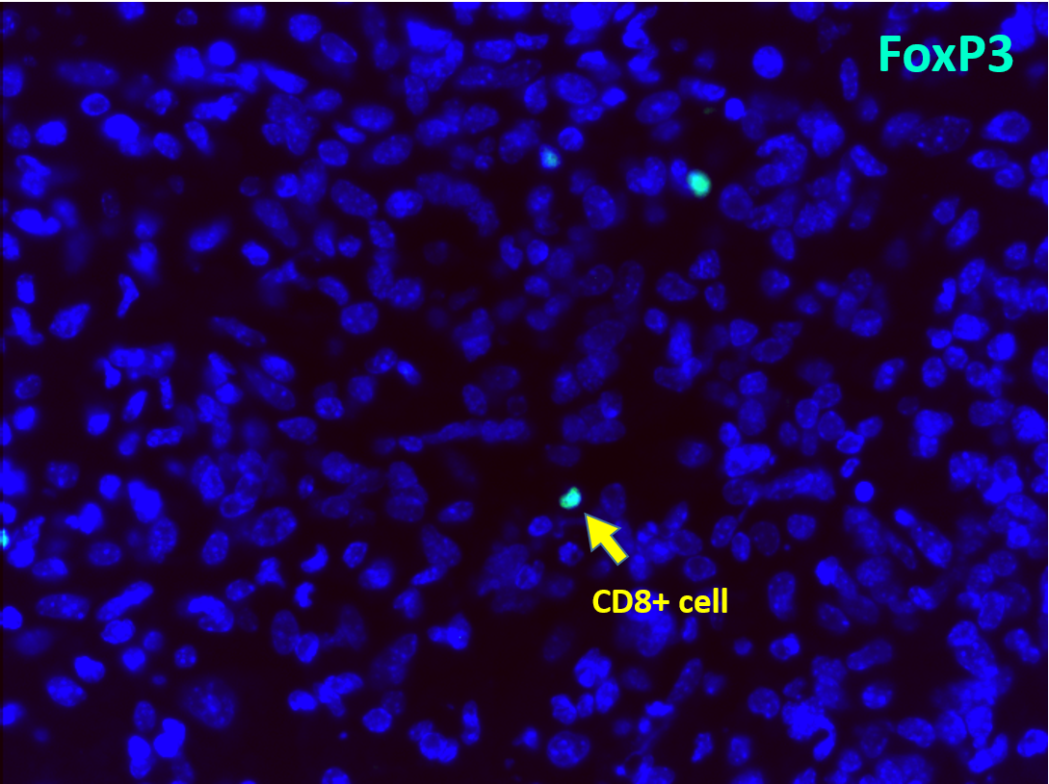
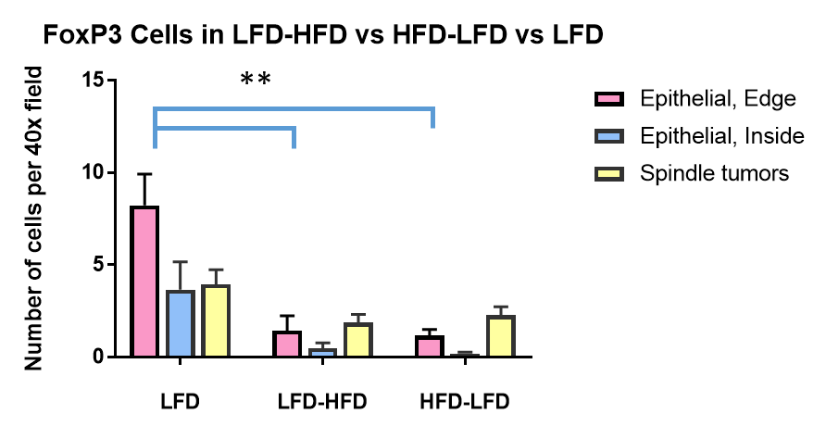
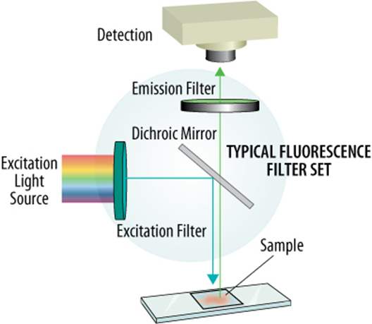
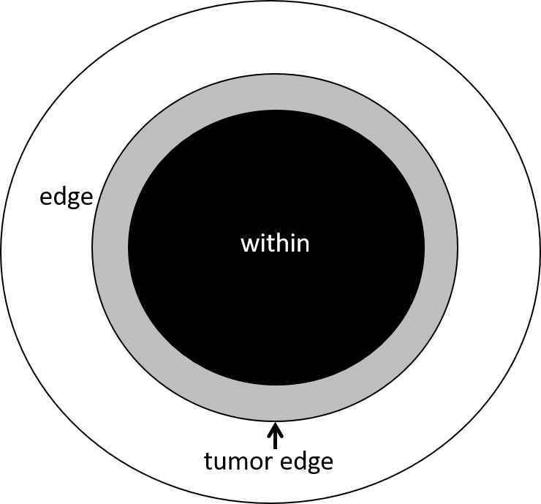
The influence of a high saturated animal fat diet on the anti-tumor immune response in mice
Yun Cheng¹, Anastasia Y. Kariagina¹, Sandra Z. Haslam², Richard C. Schwartz¹
Research Program
Breast Cancer and the Environment Research Program,
¹Department of Microbiology and Molecular Genetics, ²Department of Physiology, Michigan State University, East Lansing, MI
ABSTRACT
RESULT
Type | Function
CD4+ | Helper T-cells express the CD4 glycoprotein on their surface and are responsible for assisting other white blood cells in immune responses. They regulate an immune response by releasing cytokines. Th1 cells can help cell-mediated immunity (e.g., cytotoxic T-cells) and Th2 cells can help humoral immunity (e.g., antibody responses).
CD8+ | Cytotoxic T-cells express the CD8 glycoprotein at their surface and recognize their targets by binding to antigen associated with MHC class I molecules that are present on the surface of all nucleated cells. These cells can destroy tumor cells.
FoxP3+ | Regulatory T-cells express the FoxP3 transcription factor and have an immunosuppressive function. They normally suppress T cell-mediated immunity as an immune response is resolved, as well as suppress autoreactive T cells. They can promote tumorigenesis.
A diet enriched in animal fat is a potential factor influencing the development of breast cancer. However, it is not clear how a high fat diet (HFD) impacts the response of the immune system on tumor progression. Therefore, we investigated how HFD contributes to immune responses around tumor cells. Trp53-deficient mouse mammary tissue was chosen as a model for mammary cancer studies. Normal BALB/c mice were transplanted with Trp53-deficient mammary epithelium.
One group of mice was fed with HFD until it reached the end of puberty and then fed with a low fat diet (LFD) mouse diet. Another group was fed LFD during puberty and switched to HFD for the rest of the experiment. Control mice were fed LFD throughout the experiment. When tumors exceeded a diameter of 1cm, they were surgically removed, stained with hematoxylin and eosin, and then processed for histological analysis. Confirmed mammary tumor samples were stained with antibodies directed against CD4, CD8, and FoxP3 to analyze the types of T cells recruited in immune responses toward tumor cells. Other studies in the laboratory have identified a HFD induced increase in tumor promoting M2 macrophages associated with tumors. These are a type of macrophage that can cause immunosuppression. This leads us to hypothesize that HFD will lead to an increase in FoxP3+ regulatory T-cells that can prevent the immune system from attacking tumors, and perhaps a decrease in CD8+ T cells, which are critical in the immune response toward tumors. If this is confirmed, our studies would suggest that HFD may promote the development of breast cancer.
Epithelial, edge
Spindle
Addition of HFD increases proportions of spindle cell tumors
H&E
CD4+ cells number increased in spindle tumors in mice exposed to HFD during adulthood
EXPERIMENT DESIGN
CD4
*
CD8 + cell number decreased at the edge of epithelial tumors raised in mice given HFD in adulthood
CONCLUSIONS
High fat diet (HFD) given in adulthood leads to an increase in the recruitment of CD4+ cells to spindle cell tumors, but not epithelial tumors.
HFD given in adulthood diminishes recruitment of CD8+ cells to the epithelial tumor edge
HFD at any time in life, puberty or adulthood, decreases recruitment of FoxP3+ cells to the epithelial tumor edge.
The changes in recruitment of CD8+ and FoxP3+ T cells are, at least superficially, at odds with each other. Decreased CD8+ T cells at the epithelial tumor edge might promote tumor growth, while decreased FoxP3+ T cells might promote anti-tumor immunity.
More studies are needed to understand the effects of HFD.
CD8
Immunofluorescence (IF) relies on the use of antibodies to label a specific target antigen with a fluorescent dye. The fluorescent dye was conjugated to secondary antibodies recognizing an antibody that in turn recognizes the antigen (i.e., indirect).
http://www.abcam.com/secondary-antibodies/direct-vs-indirect-immunofluorescence
HFD given at any time decreases number of FoxP3+ cells at the edge of epithelial tumors
Images were captured with a Nikon Eclipse TE2000-U fluorescence microscope. T cells were quantified using Metamorph image processing in terms of counting positive cells per image.
Foxp3
The areas for quantitative analysis of immune cells were:
Edge – includes stroma around tumor (white) and edge of tumor (gray);
Within or inside – primarily epithelium within the tumor (black).
ACKOWLEDGEMENTS
This work was sponsored by the Breast Cancer and the Environment Research Program Grant UO1ES026119 from the National Institute of Environmental Health Sciences (NIEHS).
Notes:
1

